Slide 1

GitHub Integrations & Costs
Stav Alfi

Slide 2
GitHub Integration options
Continues Integration
Continues Deployment
Code quality
Monitoring
Project management - Agile

Slide 3
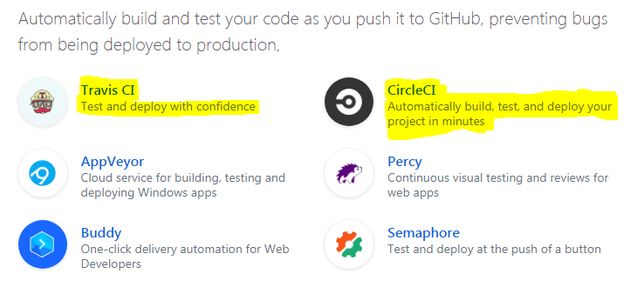
GitHub - Continues Integration

Slide 4




Continues Deployment

Slide 5
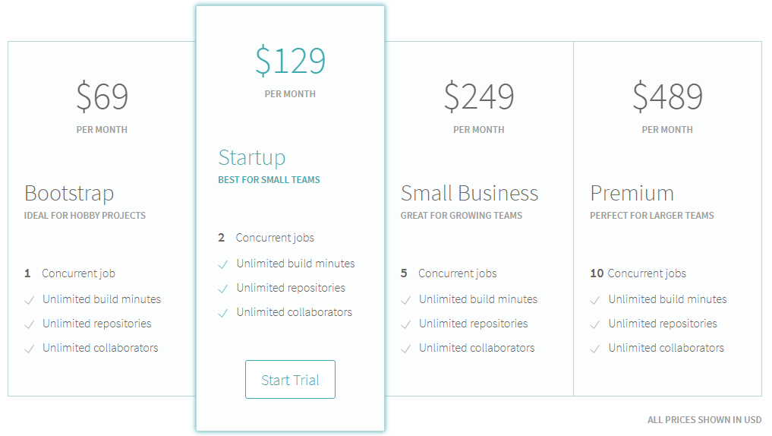
Travis CI – Continues Integration

Slide 6

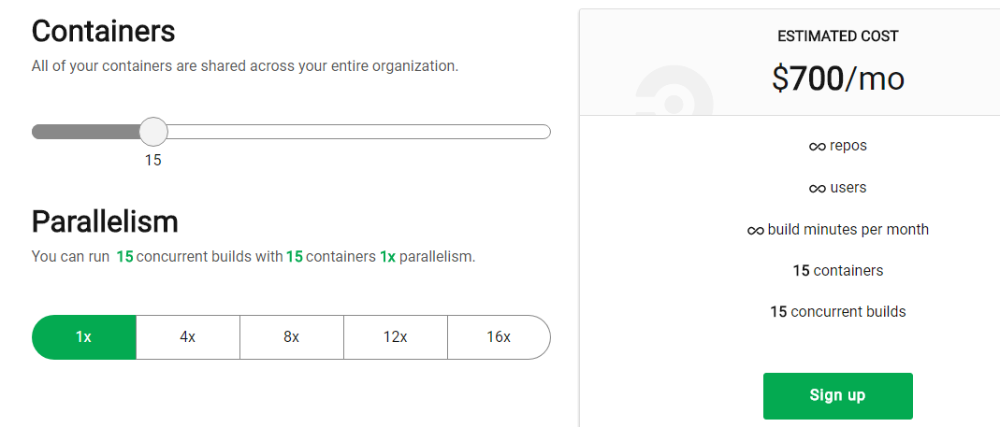
Circle CI – Continues Integration

Slide 7

Jenkins – Continues Integration
Rent Virtual machine on our clouds.
Create 300 containers using Swarm / Kubernetes.
Run builds on them.

Slide 8
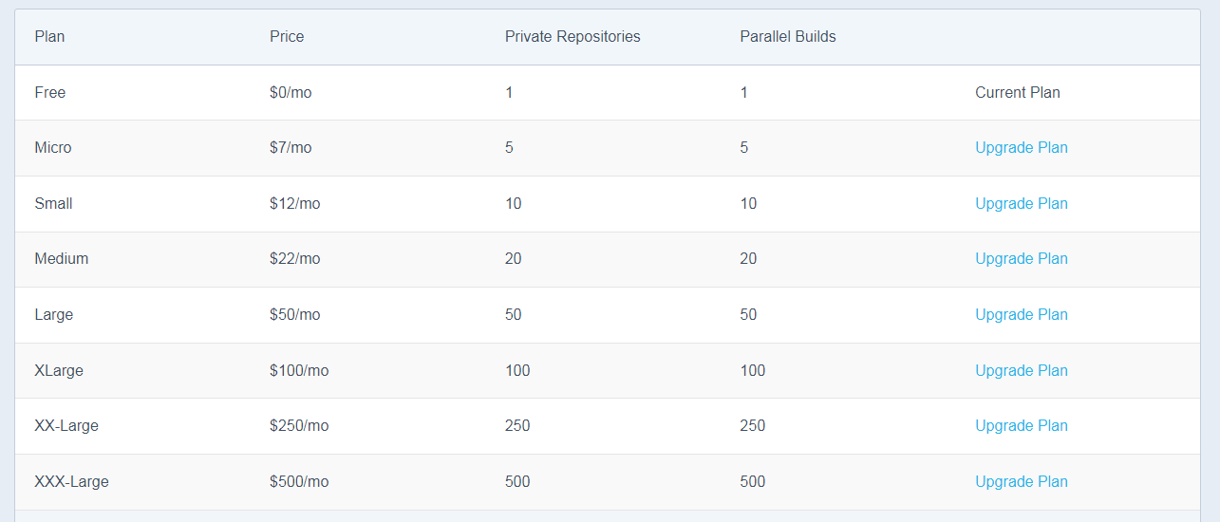
GitHub - Continues Deployment – Docker Hub

Slide 9
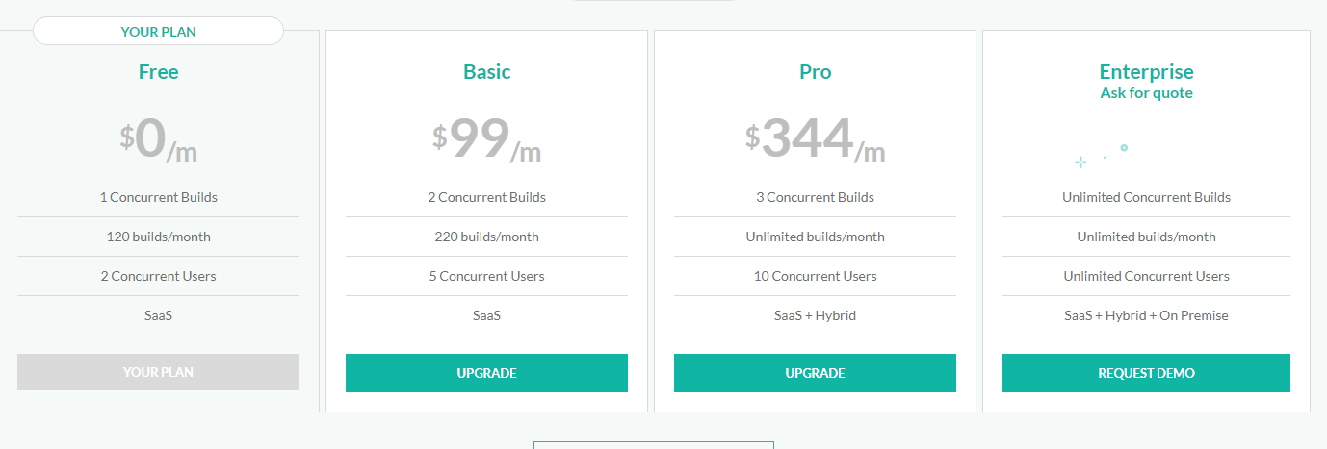
GitHub - Continues Deployment - Codefresh

Slide 10

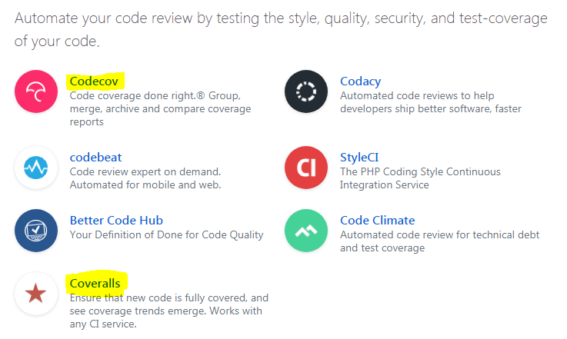
GitHub - Code quality

Slide 11
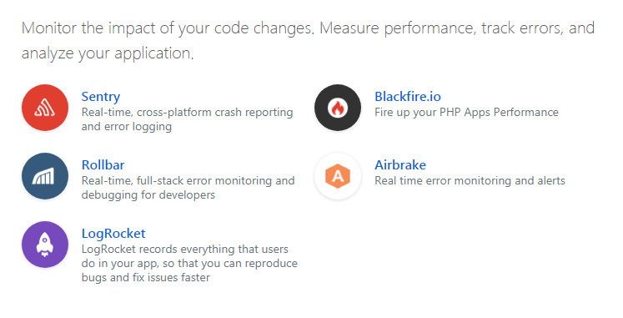
GitHub - Monitoring

Slide 12

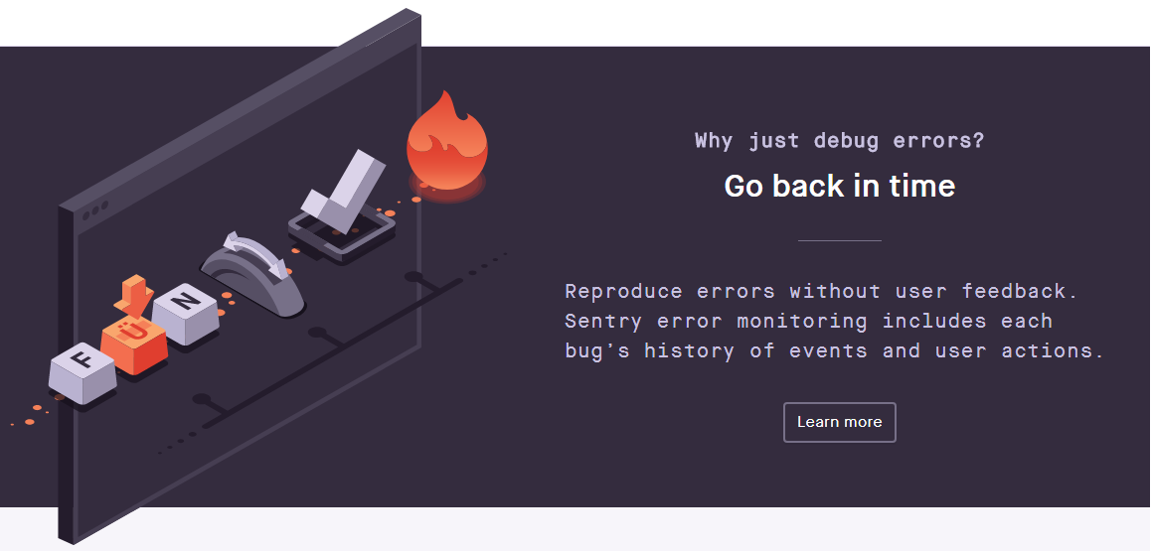
GitHub – Monitoring - Sentry

Slide 13
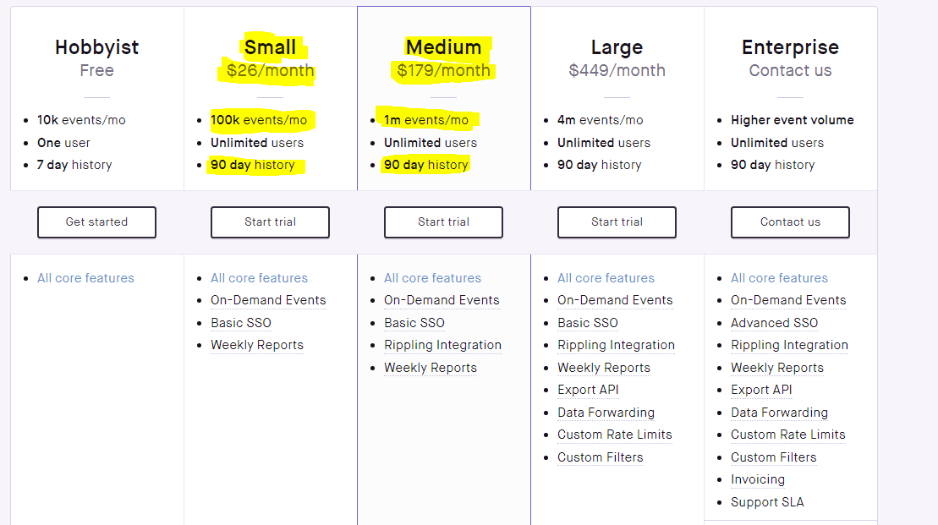
GitHub – Monitoring - Sentry

Slide 14
Bitbucket vs GitHub
 | GitHub | Bitbucket
Continues Integration | Many options and configurations (also in Web hooks) | Limited configurations
3’th party services | Many famous services | Many services
Community size | 1.5 million organizations 24 million users 67 million projects | - 6 million users

